Slide 1
2016 Nonroad Collaborative Work Group
29 August 2019
Local Conference Lines:
Main line: 202-991-0477
EPA Region 1 (Boston): 857-702-8290 EPA Region 2 (NYC): 347-384-7287
EPA Region 3 (Philadelphia): 484-352-3221 EPA Region 4 (Atlanta): 470-705-2279
EPA Region 5 (Chicago): 312-667-7115 EPA Region 6 (Dallas): 469-250-2701
EPA Region 7 (Kansas City): 913-608-8349 EPA Region 8 (Denver): 720-642-6536
EPA Region 9 (San Francisco): 628-246-1294 EPA Region 10 (Seattle): 206-800-4483
EPA RTP (Raleigh): 984-444-7480
Conference ID: 6926578

Slide 2
Meeting Agenda
Review of 2016v1 Results for Calendar Year 2028
Run Set-Up
Beta vs. v1 Comparisons for CY 2028
National Emission Summaries by Equipment Sector
County-Level Emissions by Pollutant (NO_{x}, VOC, PM_{2.5})
County-Level Emissions (NO_{x}) by Equipment Sector
2028 vs. 2016 Comparisons
National Emissions (NO_{x}, VOC, PM_{2.5}) by Equipment Sector
County-Level Differences (2028 – 2016)
Discussion/Next steps/Reminders

Slide 3
Run Set-Up
2016v1-specific inputs:
Updated Agricultural and Construction equipment allocations to the state- and county-level (Work Group update)
Updated fuel supply and county-level equipment allocations in Georgia
Temporal (month) profiles for Agricultural equipment activity in LADCO states (Illinois, Indiana, Iowa, Michigan, Minnesota, Missouri, Ohio, Wisconsin)
Emissions supplied by California (California’s suite of offroad models) and Texas (TexN2 tool)
EPA also reviewed data submitted for the 2017 NEI and incorporated into 2016v1 where appropriate, for example:
Month and spatial allocations of snowmobiles in Utah
Recreational marine allocations in Washington
Updated equipment populations in Maricopa County (AZ), Utah, Connecticut

Slide 4
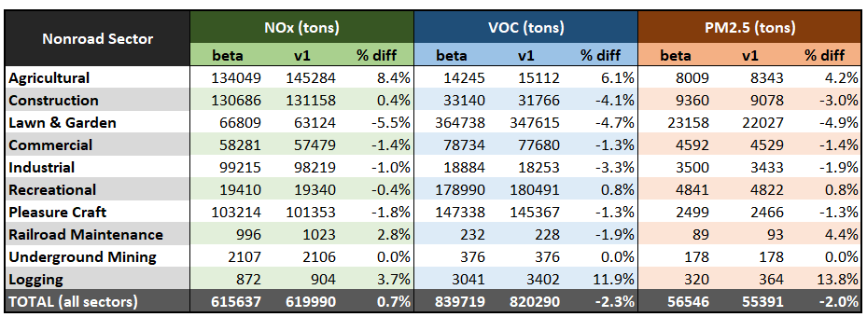
2016v1 Results: Emission Summaries by Sector (2028)
Differences between beta and v1 runs are primarily attributable to state-supplied data and work group’s update to allocation of Construction and Agricultural equipment
Reminder: beta inventory was run ‘off-the-shelf’ (no changes to model defaults)
Notes: emissions from Airport Support and Oil Field Equipment are excluded from the nonroad sector.
Above summaries include emissions from Puerto Rico and U.S. Virgin Islands.

Slide 5
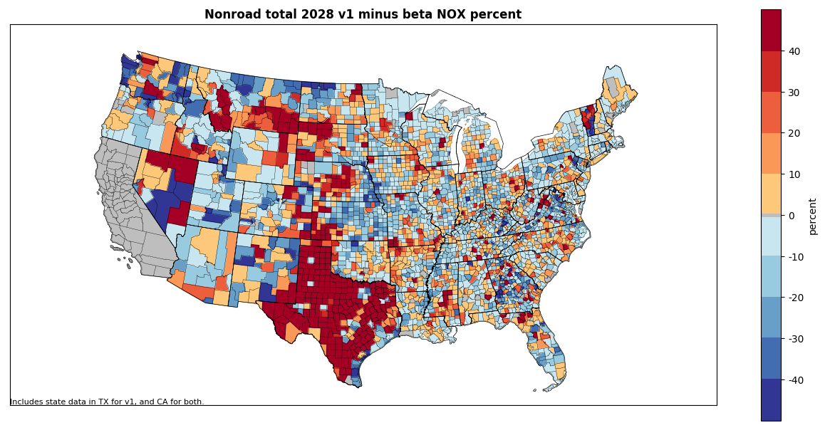
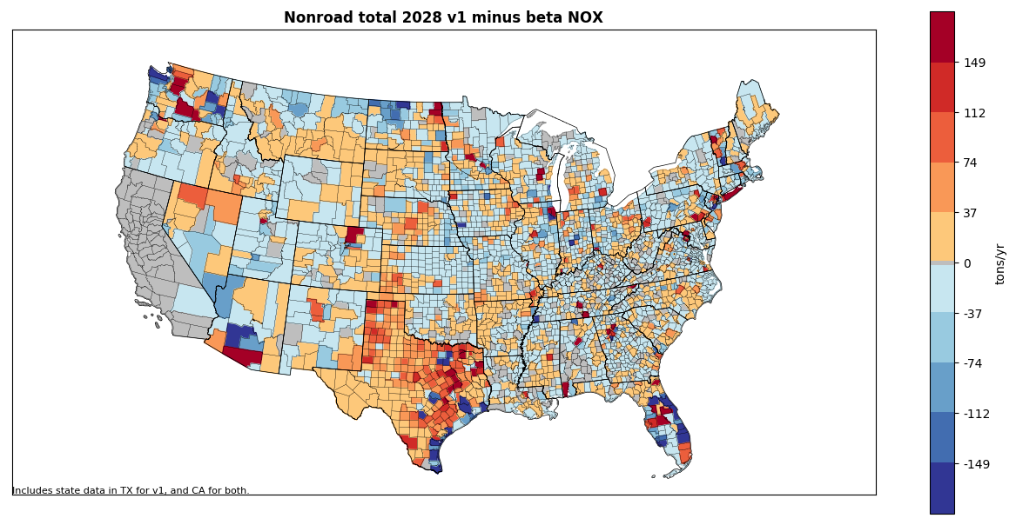
Results: 2028 Total County-Level Emissions (NOx)
All Nonroad Equipment Sectors
Difference (tons/year): v1 – beta (below)
Percent difference: v1 – beta (right)

Slide 6
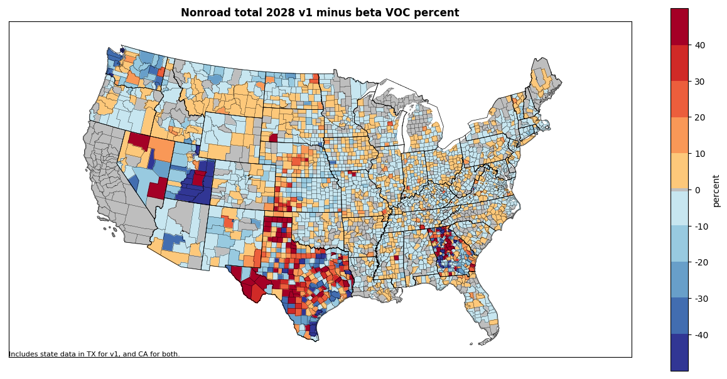
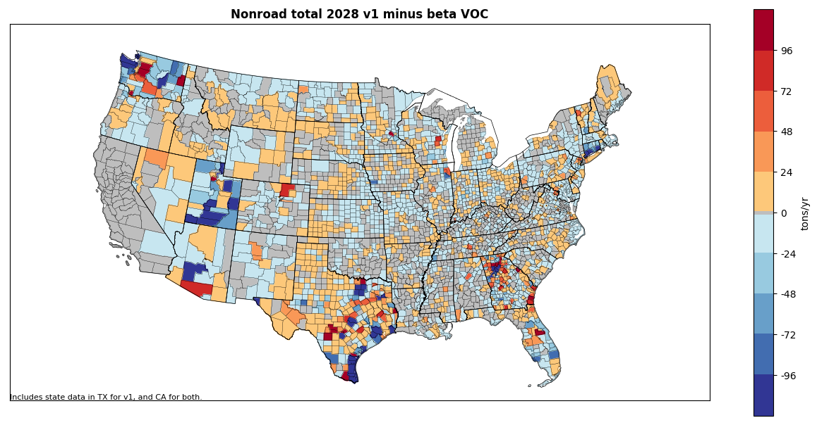
Results: 2028 Total County-Level Emissions (VOC)
All Nonroad Equipment Sectors
Difference (tons/year): v1 – beta (below)
Percent difference: v1 – beta (right)

Slide 7
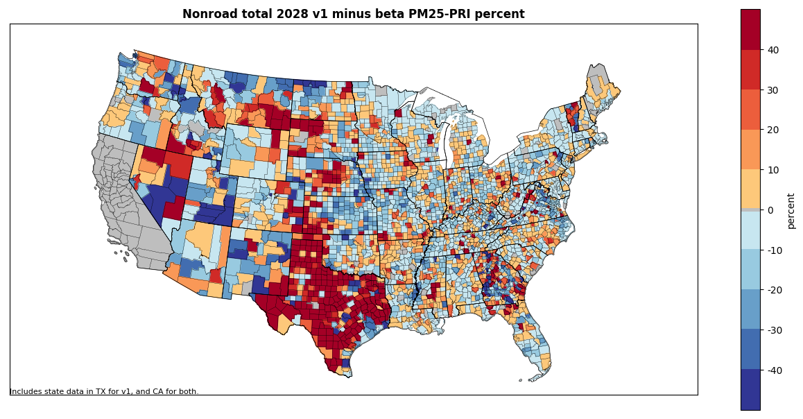
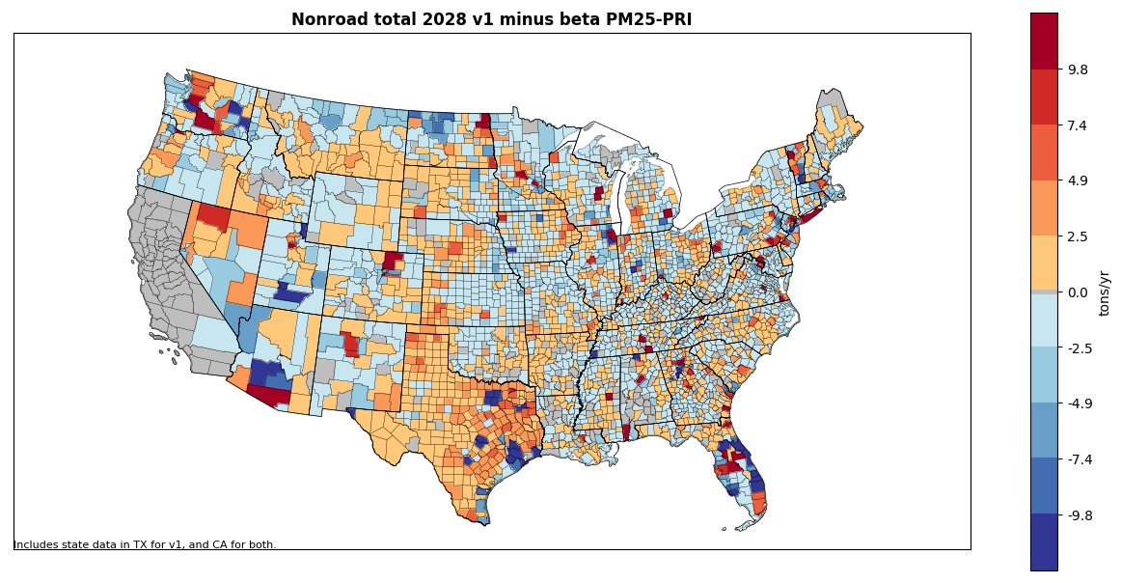
Results: 2028 Total County-Level Emissions (PM2.5)
All Nonroad Equipment Sectors
Difference (tons/year): v1 – beta (below)
Percent difference: v1 – beta (right)

Slide 8
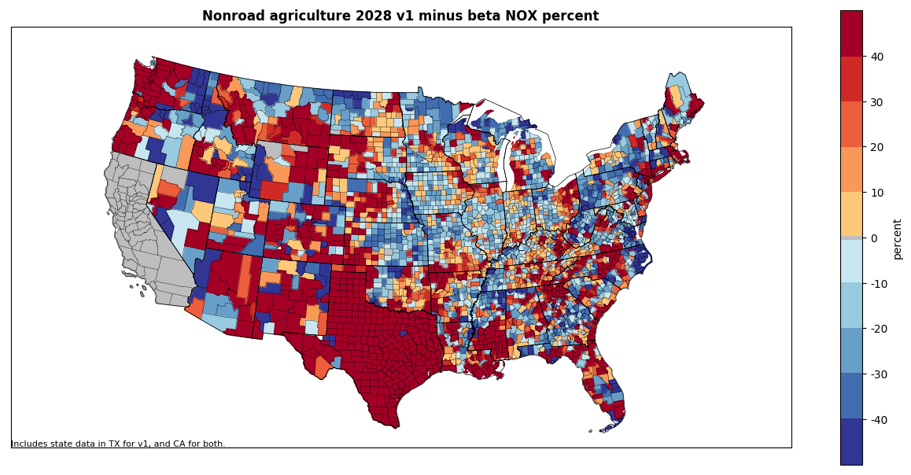
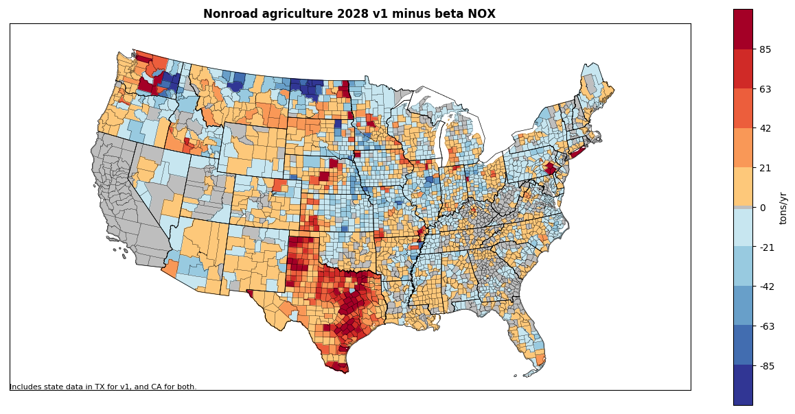
2028 Results: County-Level Emissions by Sector
Agricultural Sector
Difference (tons/year): v1 – beta (below)
Percent difference: v1 – beta (right)
Includes:
Updated equipment allocations (state- and county-level)
Updated temporal profiles for LADCO states
Emissions supplied by Texas and California
Updated fuel formulation in Georgia

Slide 9
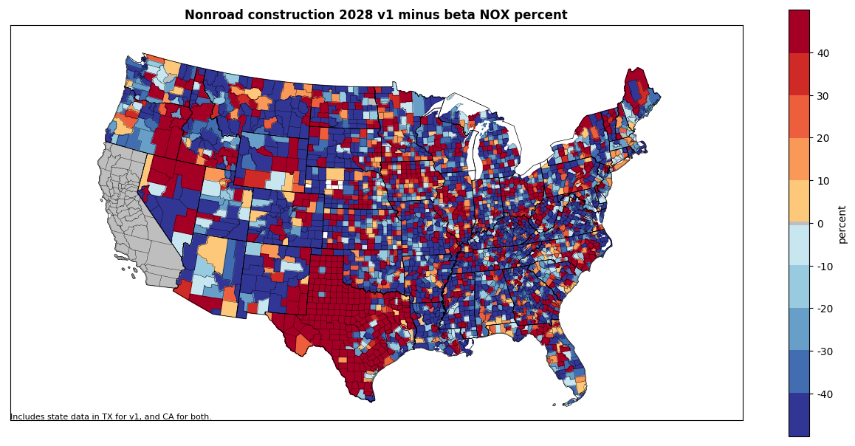
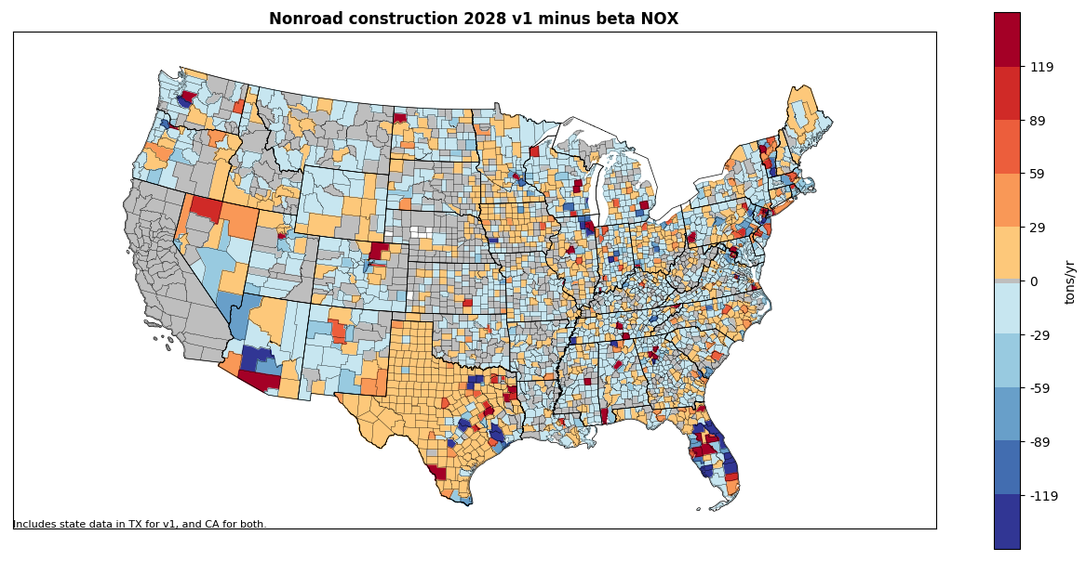
2028 Results: County-Level Emissions by Sector
Construction Sector
Difference (tons/year): v1 – beta (below)
Percent difference: v1 – beta (right)
Includes:
Updated equipment allocations (state- and county-level)
Emissions supplied by Texas and California
Updated fuel formulation in Georgia

Slide 10
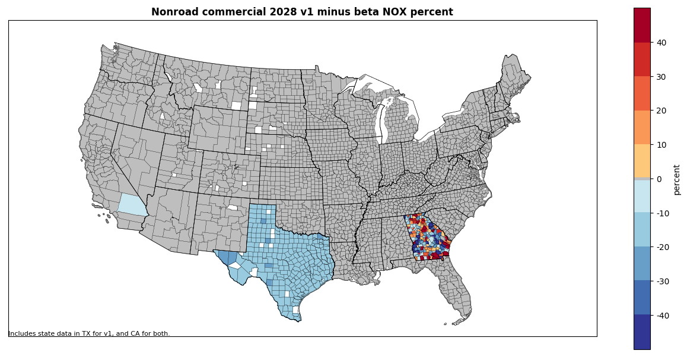
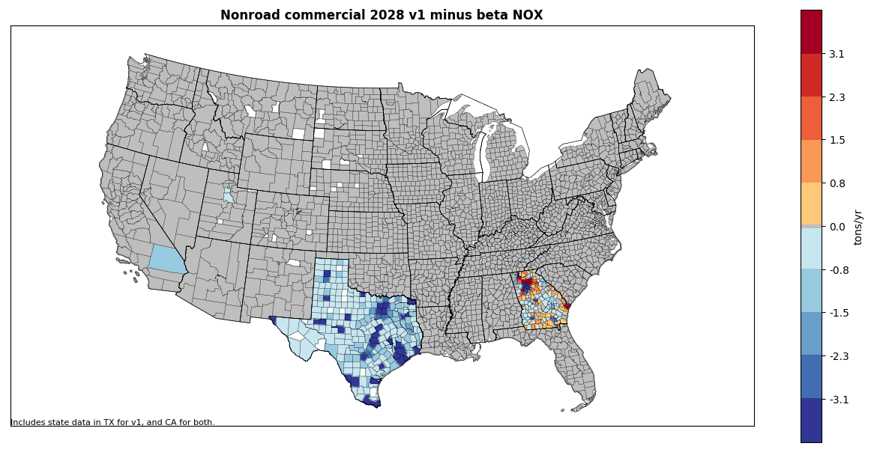
2028 Results: County-Level Emissions by Sector
Commercial Sector
Difference (tons/year): v1 – beta (below)
Percent difference: v1 – beta (right)
Includes:
Updated spatial allocations and fuel formulation in Georgia
Emissions supplied by Texas and California

Slide 11
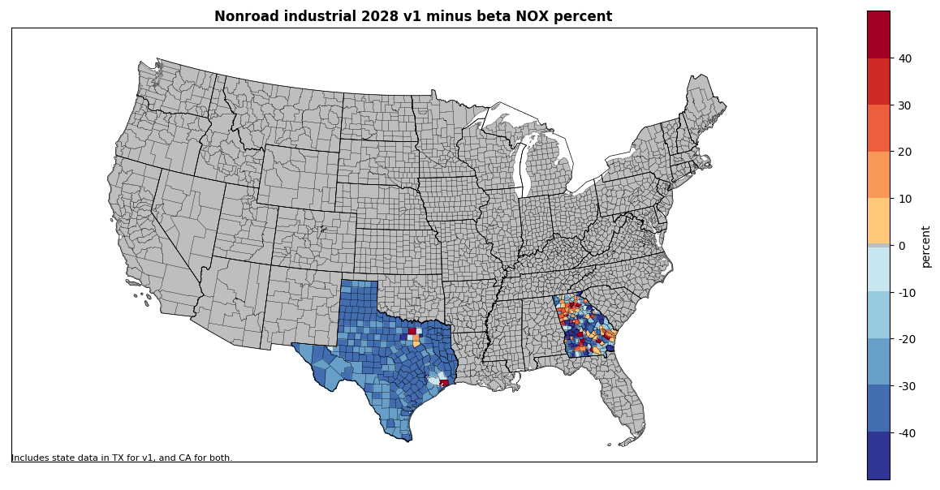
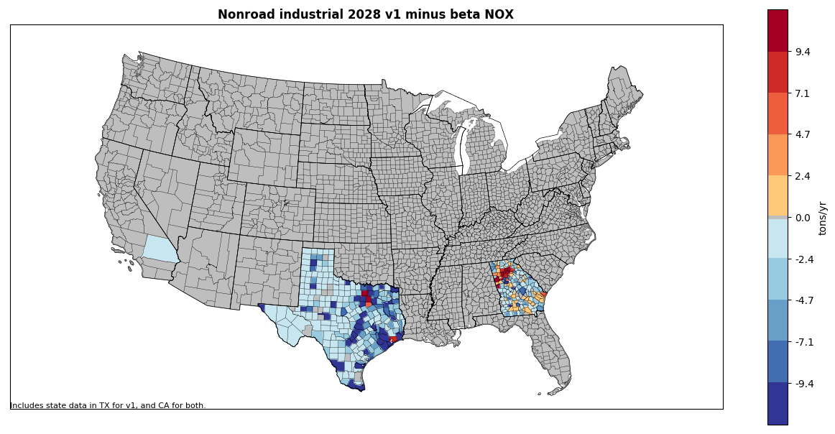
2028 Results: County-Level Emissions by Sector
Industrial Sector
Difference (tons/year): v1 – beta (below)
Percent difference: v1 – beta (right)
Includes:
Updated spatial allocations and fuel formulation in Georgia
Emissions supplied by Texas and California

Slide 12
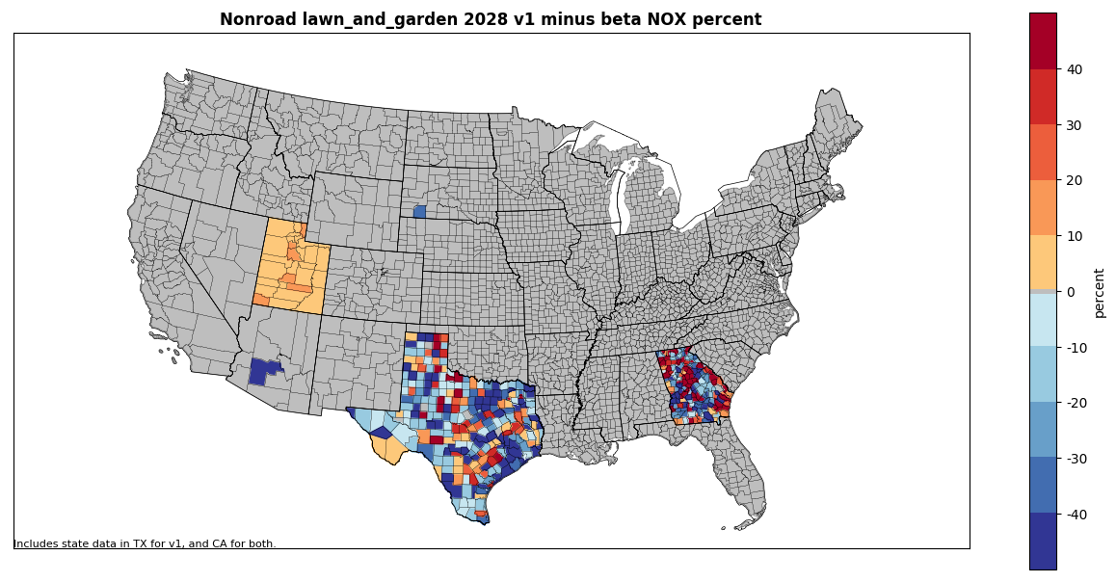
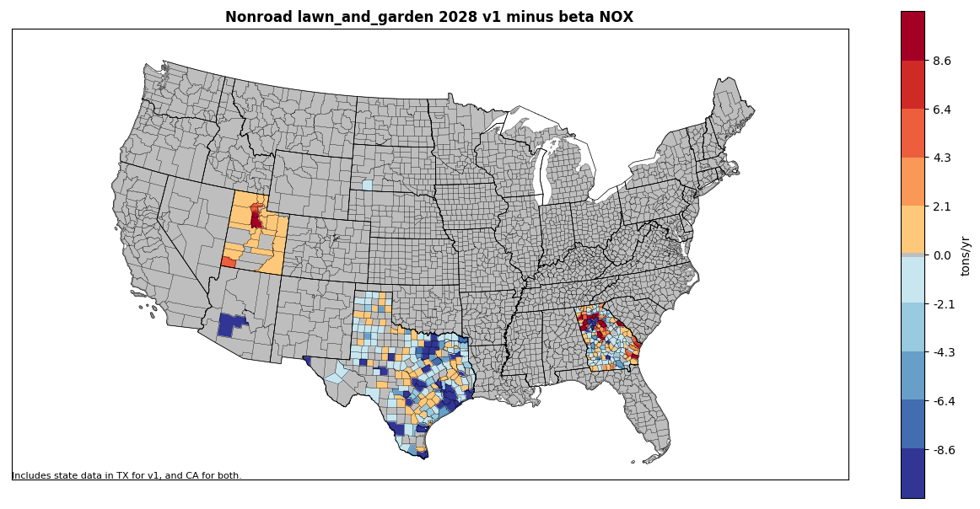
2028 Results: County-Level Emissions by Sector
Lawn & Garden Sector
Difference (tons/year): v1 – beta (below)
Percent difference: v1 – beta (right)
Includes:
Updated spatial allocations and fuel formulation in Georgia
Updated populations in Maricopa County
Emissions supplied by Texas and California
Deltas in Utah are an artifact of submitted population base years that differ from MOVES defaults

Slide 13
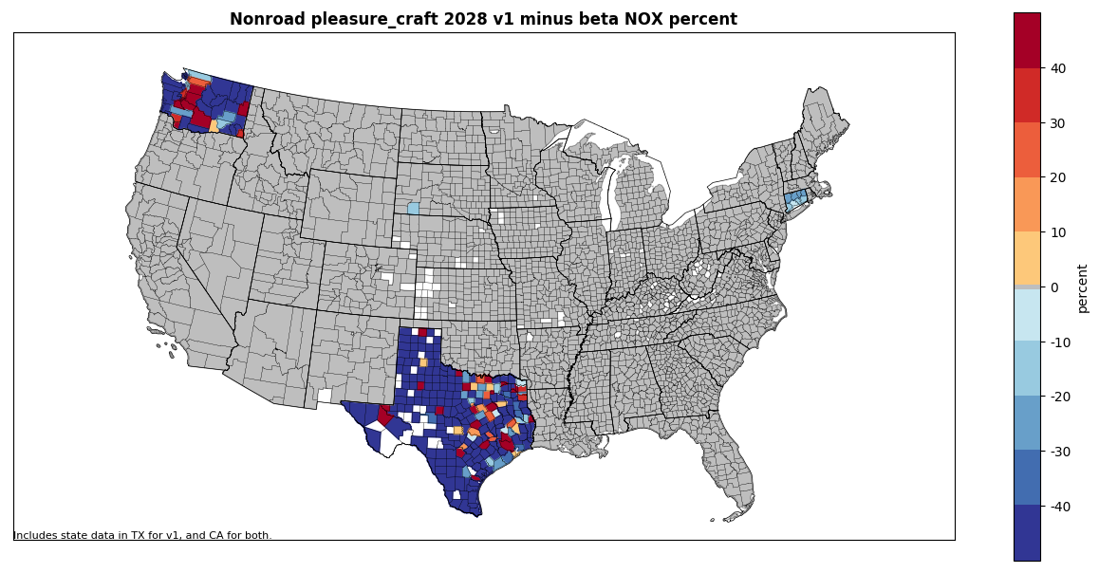
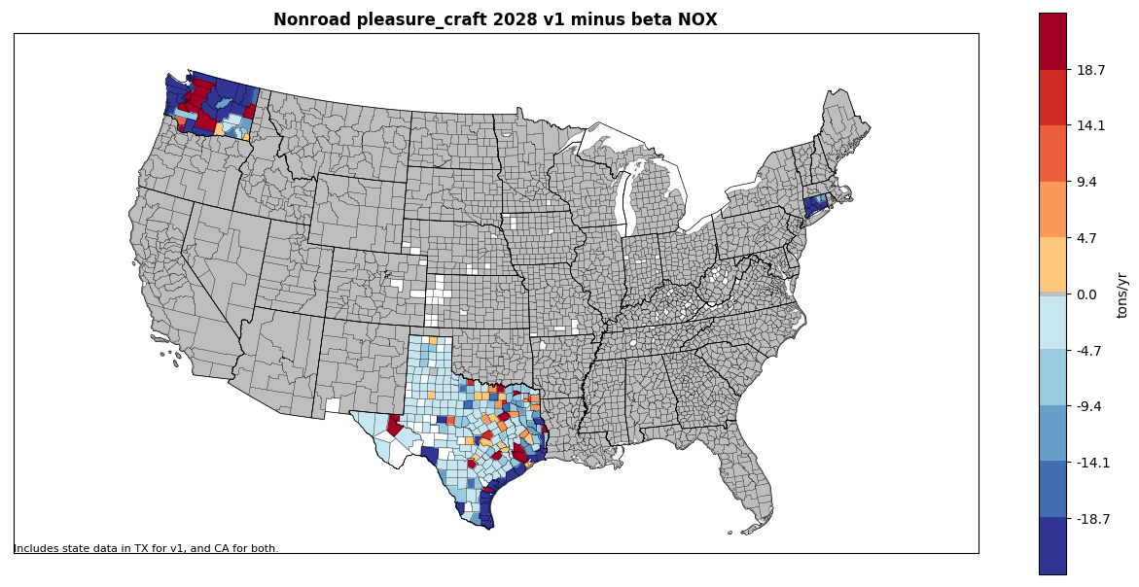
2028 Results: County-Level Emissions by Sector
Recreational Marine Sector
Difference (tons/year): v1 – beta (below)
Percent difference: v1 – beta (right)
Includes:
Updated spatial allocations in Washington
Updated populations in Connecticut
Emissions supplied by Texas and California

Slide 14
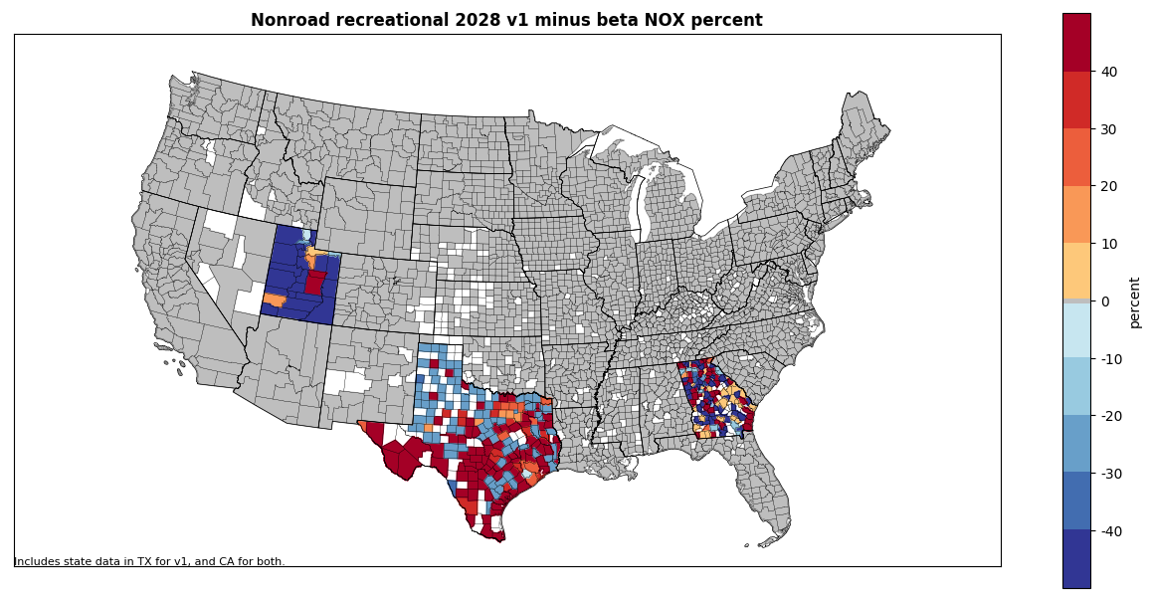
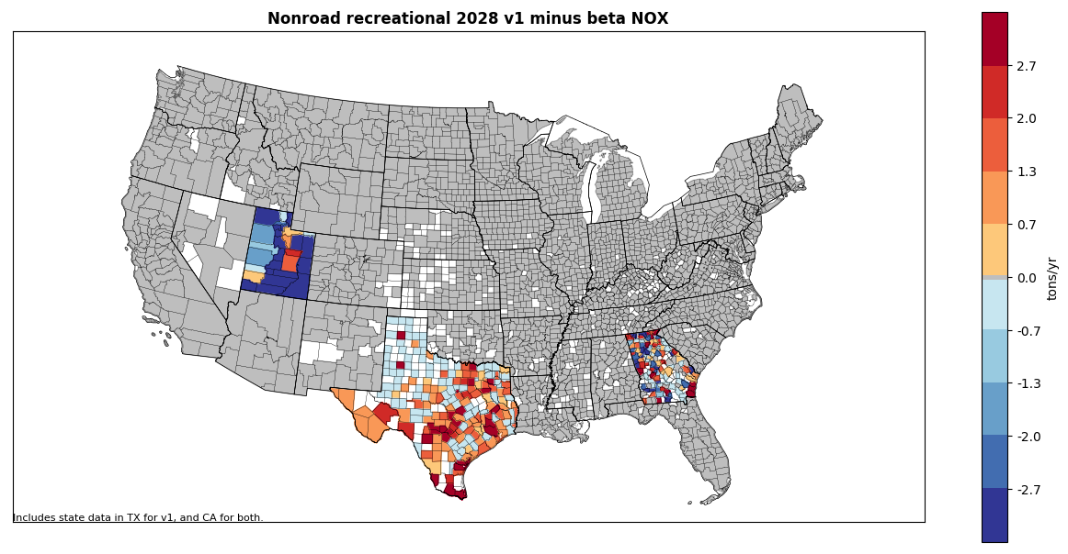
2028 Results: County-Level Emissions by Sector
Recreational Vehicles Sector
Difference (tons/year): v1 – beta (below)
Percent difference: v1 – beta (right)
Includes:
Updated spatial allocations and fuel formulation in Georgia
Updated snowmobile populations and month allocations in Utah
Emissions supplied by Texas and California

Slide 15
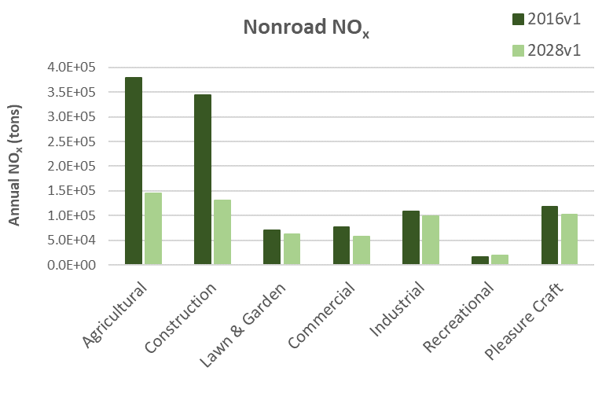
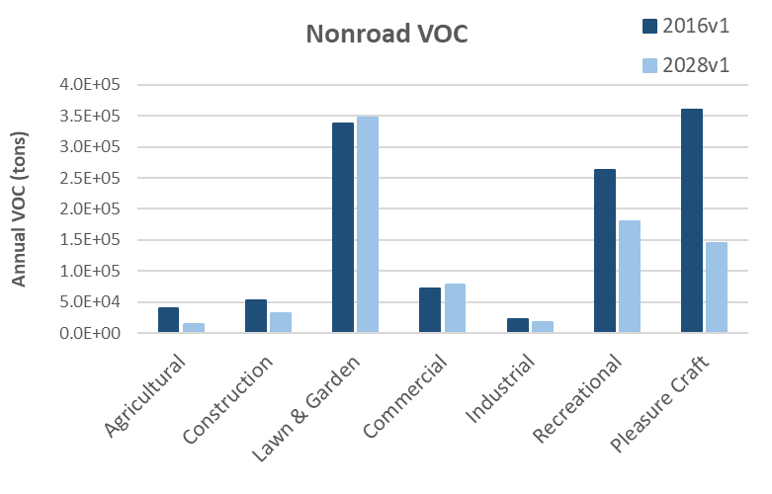
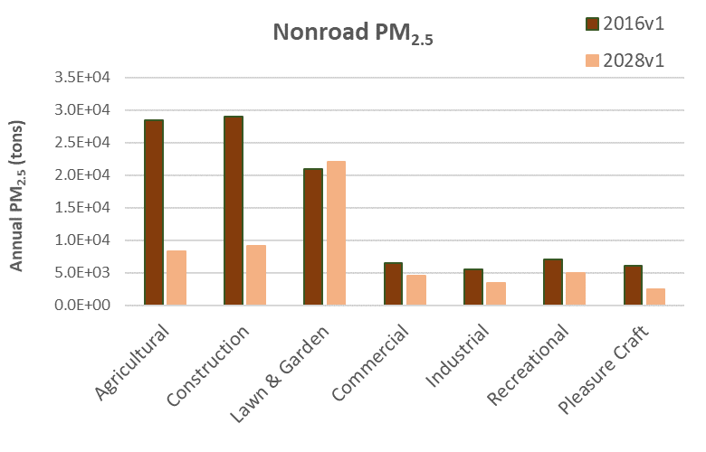
v1 Results: 2016v1 vs 2028v1
-61.6%
-59.6%
-61.9%
+2.9%
-31.3%
-9.2%
-13.6%
-10.5%
-25.8%
-62.9%
-39.8%
+7.0%
+21.5%
-17.4%
-70.6%
-68.8%
Above plots do not include Logging, Underground Mining, and Railway Maintenance sectors (small values relative to other sectors)
Largest percent decreases from 2016 to 2028 are seen primarily in the diesel-heavy sectors (Construction, Agriculture, etc.)
+5.0%
-30.2%
-37.9%
-30.4%
-59.2%

Slide 16
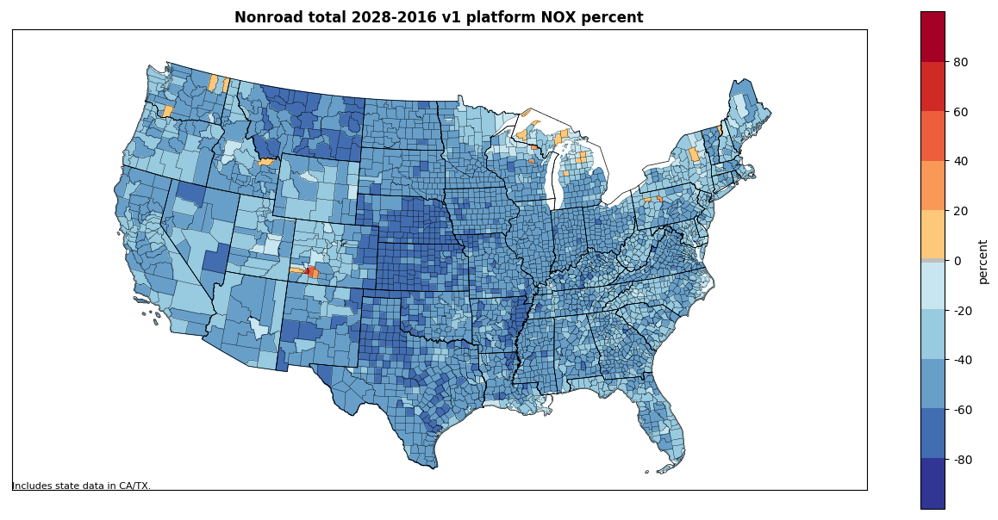
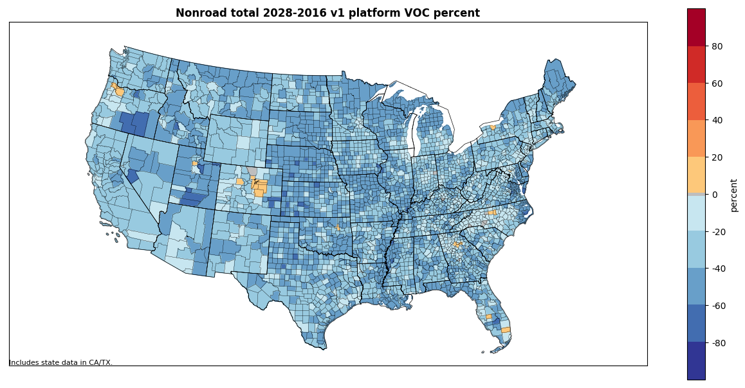
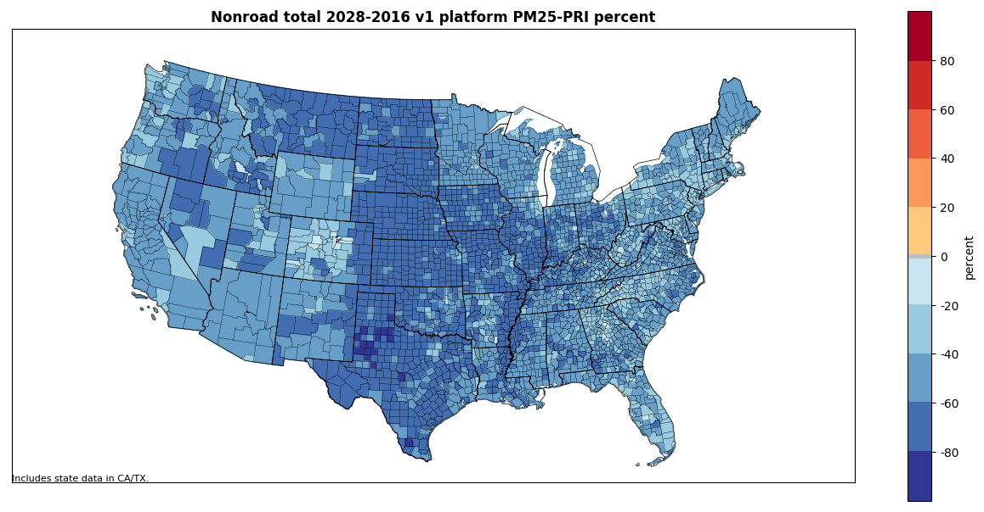
v1 Results: 2016v1 vs 2028v1
National Summary
Pollutant | % difference (2028-2016)
NO_{x} | -44.8%
VOC | -28.9%
PM_{2.5} | -47.1%
PM₁₀ | -46.3%
SO₂ | -27.7%
CO | +2.9%

Slide 17
Discussion/Next Steps/Reminders
Discussion/questions
Next steps:
All: review and provide comment on 2016v1 summaries for CY2016 and CY2028
EPA: incorporate TexN2 emissions for 2023
EPA: re-run Utah with corrected base year equipment population table
EPA: compile 2016v1 documentation
EPA: post final v1 base and future year files (mid-September)
Emissions summaries, county plots, and other information:
2016 v1 emission summaries and maps: ftp://newftp.epa.gov/air/emismod/2016/v1/reports/nonroad/
2016 beta summary files on Google Drive: https://drive.google.com/drive/u/0/folders/1yFEmYlWgcjKkeS48UQ0SerYZdpTY0oEm
Work Group meeting minutes and related files and links available on Work Group wiki: http://views.cira.colostate.edu/wiki/wiki/9179

